Slide 1
NATURAL LANGUAGE PROCESSING

Slide 2
Synopsis
Introduction to NLP
Natural language processing techniques in python

Slide 3
Introduction
What is Natural Language Processing ?
Started off as a branch of Artificial Intelligence
Process information contained in natural language text.
Analyze, understand and generate human languages just like humans do
Make computers learn our language rather than we learn theirs

Slide 4




Why is natural language processing important?
Businesses use massive quantities of unstructured, text-heavy data and need a way to efficiently process it.
NLP makes it possible for computers to read text, hear speech, interpret it, measure sentiment and determine which parts are important.
Notes:
Usually from documents and through code provides structure to this type of information by identifying patterns, topics and entities.

Slide 5
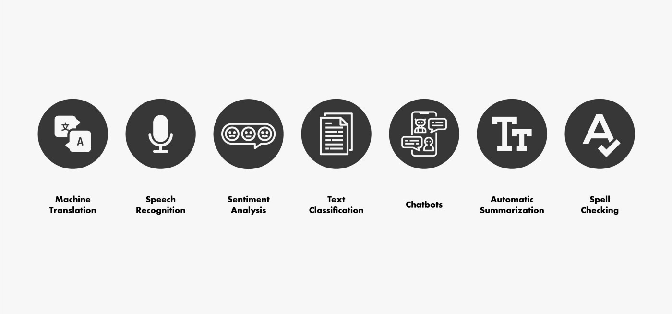
Applications of NLP
Notes:
1. Machine Translation
Machine translation (MT) refers to the automatic translation of a segment of text from one language to another.
2. Speech Recognition
We are all familiar with Google Assistant, Apple’s Siri, Amazon’s Alexa, and Microsoft’s Cortana, and so on. all those virtual assistants AI technologies are built based on Automatic Speech Recognition (ASR) and Natural Language Understanding (NLU), a procedure of converting speech into words, sounds, and ideas.
So speech recognition is simply the ability of a software to recognize speech.
3. Sentiment Analysis
Sentiment Analysis (also known as opinion mining or emotion AI) is an interesting type of data mining that measures the inclination of people’s opinions.
4. Text Classification
Text classification also known as text tagging or text categorization is the process of assigning a set of predefined categories to free-text or categorizing text into organized groups.
There are many interesting applications for text classification such as spam detection, email routing and sentiment analysis etc…
5. Chatbots
Chatbots are applications that interact with users, usually over text, via websites or integrated into other platforms to ensure that customers get answers to their questions or find what they’re looking for, in real time.
The importance of NLP for a chatbot application is in making the customer feel understood in real time.
6. Automatic Summarization
Automatic Summarization or Text summarization is the technique for generating a concise, meaningful and precise summary of voluminous texts (such as books, news articles, blog posts, research papers, emails, and tweets) while focusing on the sections that convey useful information, and without losing the overall meaning.
7. Spell Checking
A spell checker or spell corrector is a technique which identifies the incorrect or misspelled words in a block of text and replaces them with the best possible combination of correct words.
Spell checking is one of the applications of Natural Language Processing that impacts billions of users daily, and most text editors (like Microsoft Word for example) or even search engines let users check if their text contains spelling mistakes.

Slide 6
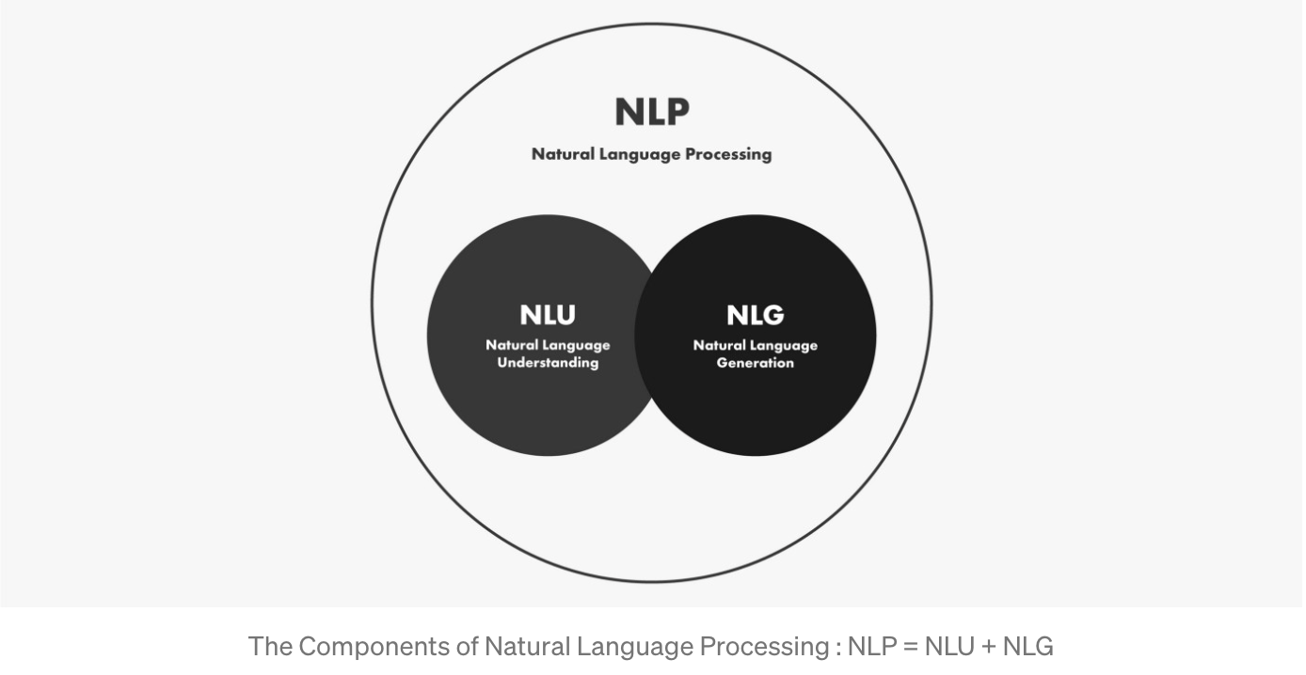
Components of NLP
Generally Natural Language Processing can be split into two parts
Notes:
1. Natural Language Understanding (NLU)
NLU or Natural Language Understanding is a subset of NLP that is responsible for the semantic parsing and analysis, entities extracting…etc. NLU tries to structure the input data to understand the meaning behind written text.
For example after having the speech recognition software convert speech into text, The NLU system comes into the picture to decipher its meaning.
2. Natural Language Generation (NLG)
NLG or Natural Language Generation is the step when the machine tries to transform the structured (from NLU) data into human-readable language, so NLG does exactly the opposite of NLU.

Slide 7
Common NLP libraries
a. NLTK (Natural Language Toolkit)
The NLTK Python framework is generally used as an education and research tool. It’s not usually used on production applications. However, it can be used to build exciting programs due to its ease of use.
b. Spacy
spaCy is an open-source natural language processing Python library designed to be fast and production-ready. spaCy focuses on providing software for production usage.

Slide 8
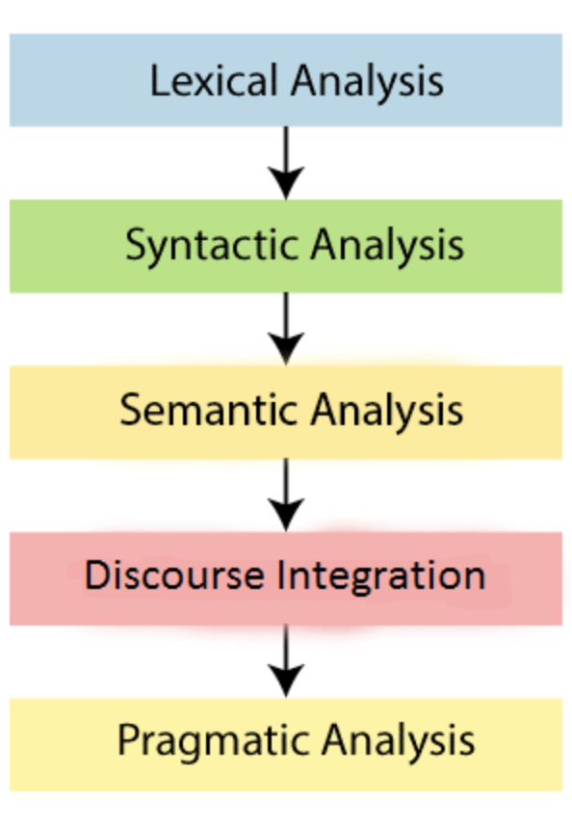
Phases of NLP
a. Lexical Analysis:
Lexical Analysis divide a whole chunk of text into paragraphs, sentences, and words. It involves identifying and analyzing words’ structure.
b. Syntactic Analysis:
Syntactic Analysis is used to check grammar, word arrangements, and shows the relationship among the words.
c. Semantic Analysis:
Semantic analysis draws the exact meaning for the words, and it analyzes the text meaningfulness.
d. Disclosure Integration:
Disclosure integration takes into account the context of the text.
e. Pragmatic Analysis:
Pragmatic analysis deals with overall communication and interpretation of language. It deals with deriving meaningful use of language in various situations.
Notes:
b. Example: Agra goes to the Poonam
In the real world, Agra goes to the Poonam, does not make any sense, so this sentence is rejected by the Syntactic analyzer.
c .Sentences such as “hot ice-cream” do not pass.
d. For example: “He works at Google.” In this sentence, “he” must be referenced in the sentence before it.

Slide 9
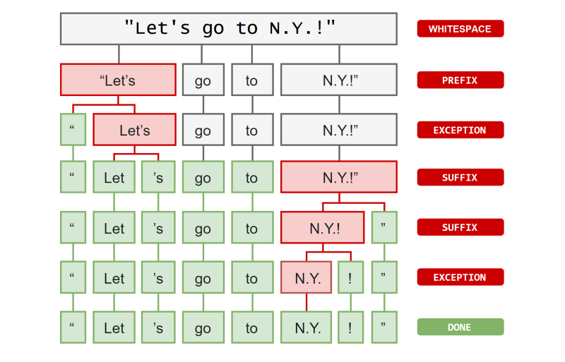
NLP Techniques
Tokenization
It is the process of breaking up the original text into component pieces(tokens)
Notes:
Tokens are basic building blocks of a doc object. Everything that help us understand the meaning of the text is derived from tokens and their relationship to one another.
prefix,those were the characters at the beginning.
suffix, characters at the end.
infix, which are the characters in between
the prefix and the suffix.
Exception which is a special case rule to split a string
into several tokens or prevent a token
from being split when punctuation rules are applied.

Slide 10
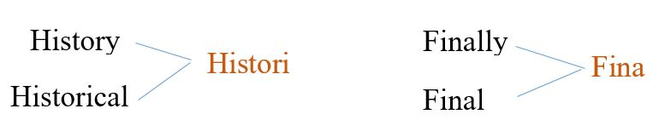
Stemming
Stemming is a technique used to extract the base form of the words by removing affixes from them. It is just like cutting down the branches of a tree to its stems.
For example, the stem of the words eating, eats, eaten is eat.
Drawback:
Notes:
Stemming works fairly well in most cases,
but unfortunately, English has so many exceptions
where a more sophisticated process is usually required.

Slide 11
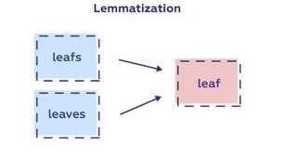
Lemmatization
The purpose of lemmatization is same as that of stemming but overcomes the drawbacks of stemming.
It considers the context and converts the word to its meaningful base form, which is called Lemma.

Slide 12
Stop Words
Stop words are a set of commonly used words in any language.
For example, in English, “the”, “is” and “and”
stop words are used to eliminate unimportant words, allowing applications to focus on the important words instead.

Slide 13
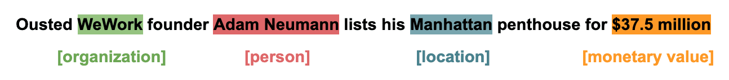
Named Entity Recognition (NER)
Seeks to locate and classify named entity mentions in unstructured text into pre-defined categories, such as the person names, organizations, locations etc
At its core, NER is just a two-step process, below are the two steps that are involved:
  Detecting the entities from the text
  Classifying them into different categories

Slide 14
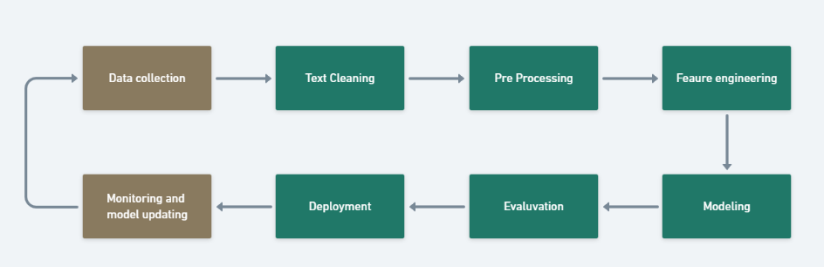
Text Classification
Classifying text into given classes
Example:
Fraud detection
Spam detection
Sentiment Analysis
Analyzing movie review (Positive or negative)
General Text Classification Pipeline

Slide 15
Feature Extraction
Most classic machine learning algorithms can't actually accept or take in raw text.
Instead, we need to perform some sort of feature extraction from the raw text in order to pass numerical features to the machine learning algorithm.

Slide 16
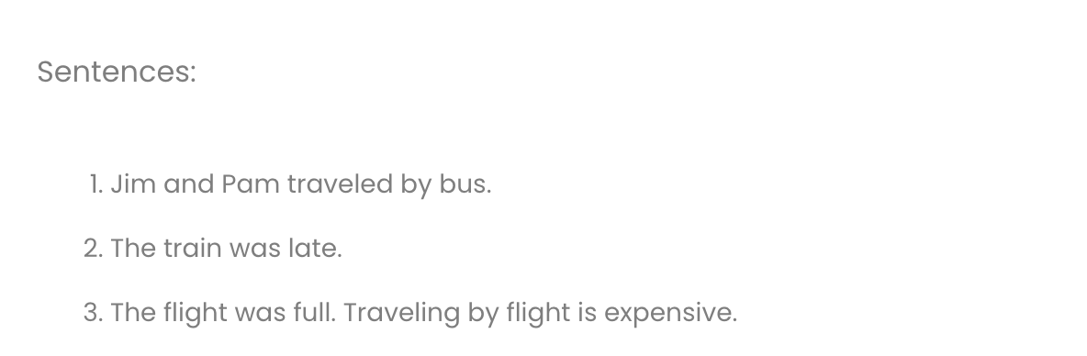
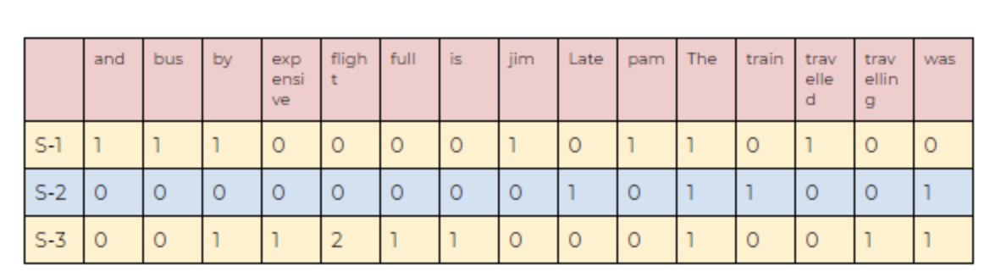
Techniques for Feature extraction or Vectorization
Count Vectorizers:
Count Vectorizer is a way to convert a given set of strings into a frequency representation.
Limitations:
Semantic meaning: It does not consider the semantic meaning of a word. It ignores the context in which the word is used.
Vector size: For large documents, the vector size increase, which may result in higher computational time.
Preprocessing: In preprocessing, we need to perform data cleansing before using it.

Slide 17
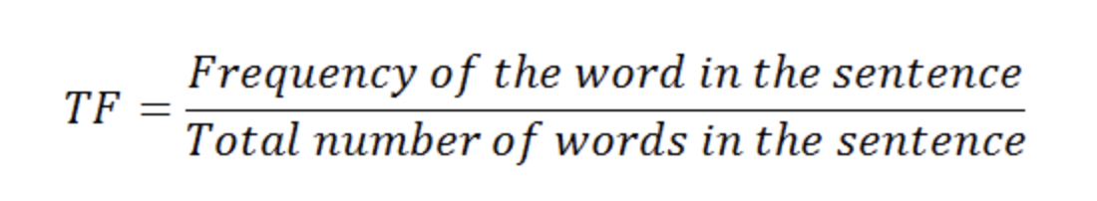
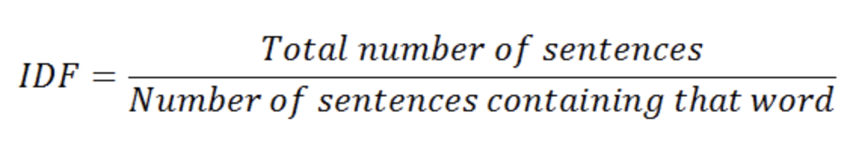
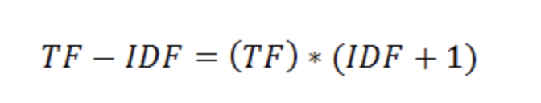
TF-IDF
TF-IDF stands for Term Frequency — Inverse Document Frequency, which is a scoring measure generally used in information retrieval (IR) and summarization. The TF-IDF score shows how important or relevant a term is in a given document.
If a particular word appears multiple times in a document, then it might have higher importance than the other words that appear fewer times (TF).
At the same time, if a particular word appears many times in a document, but it is also present many times in some other documents, then maybe that word is frequent, so we cannot assign much importance to it. (IDF).
Calculate TF-IDF

Slide 18
TEXT CLASSIFICATION – HANDS ON

Slide 19

Questions

